Slide 1
CUSTOMER REVIEW ANALYSIS
BRITISH AIRWAYS
Dipesh Patel

Slide 2
Today’s Discussion
Introduction
Web Scrapping
Data Cleaning
Text Analytics
Summary

Slide 3
Introduction
Web Scrapping reviews for British Airways.
Data Cleaning of the reviews.
Using Beautiful Soup for Web Scrapping

Slide 4
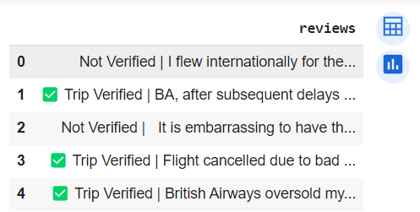
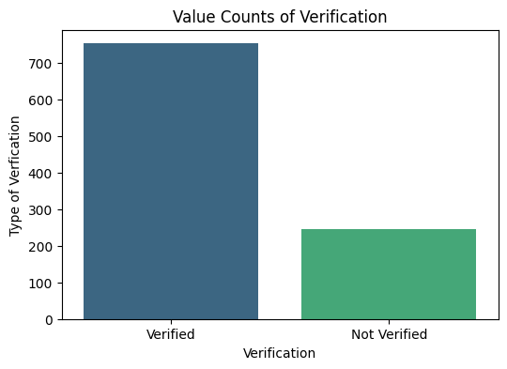
Web Scrapping
Using Beautiful Soup for Web Scrapping and gathering all the reviews.
Before Cleaning took an insight which reviews are Verified and Not Verified.

Slide 5
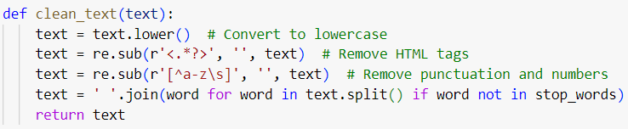
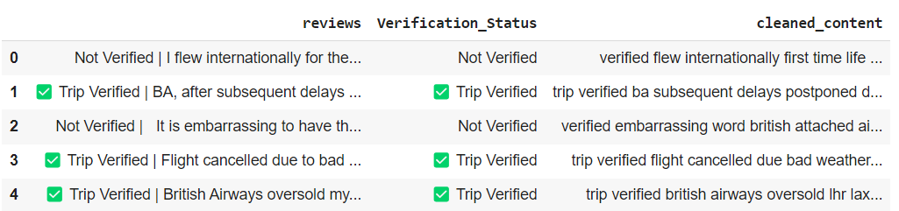
Data Cleaning
Using NLTK (Stop Words) , punctuations, special characters, and lowering the text so that its easily comparable.

Slide 6
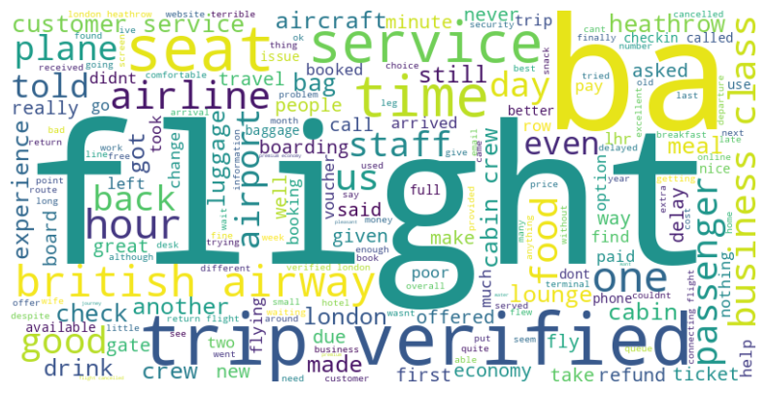
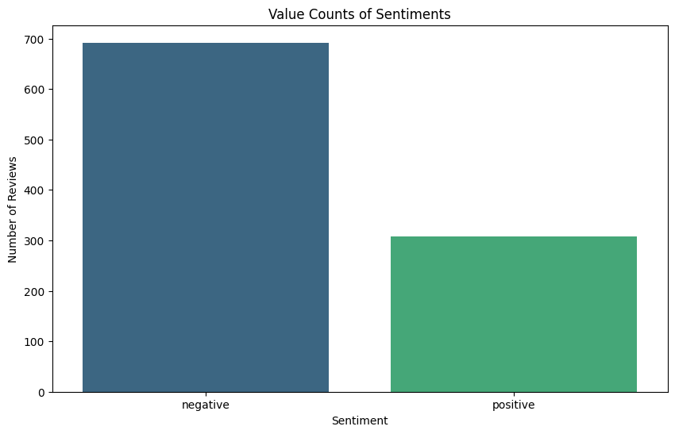
Text & Data Analytics
Using Word Cloud, we can check the frequency distribution of the words from the customer reviews.
Sentiments Distribution

Slide 7
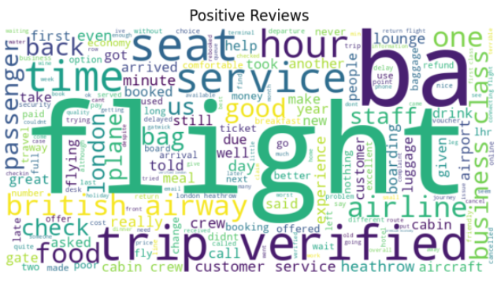
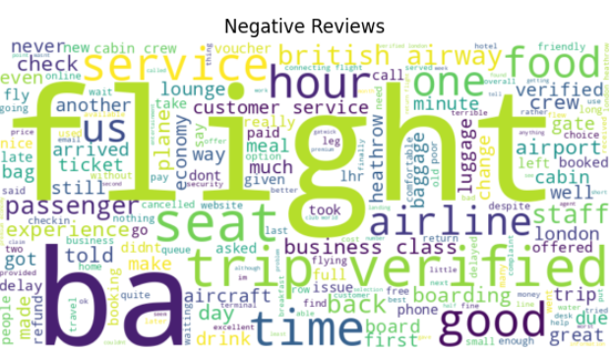
Text & Data Analytics
Word Cloud for Positive Sentiments and Negative Sentiments. This helps us in identifying the words frequency in each sentiment and on which Topic it has been distributed.

Slide 8
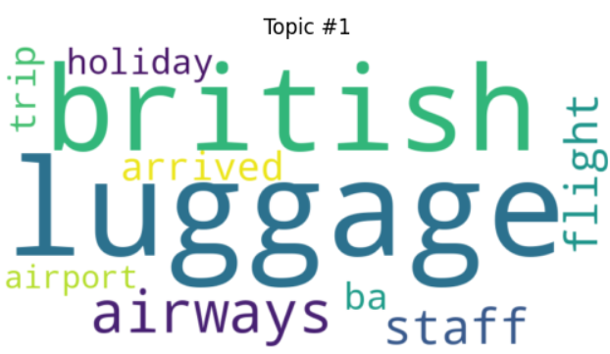
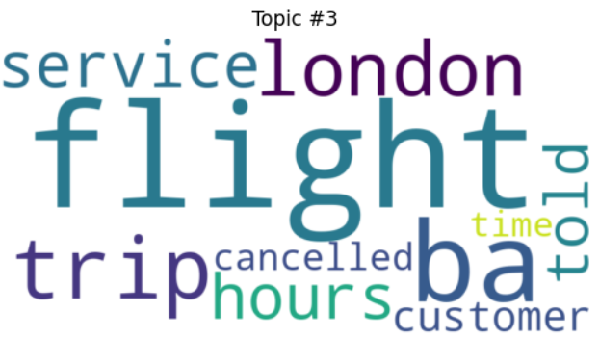
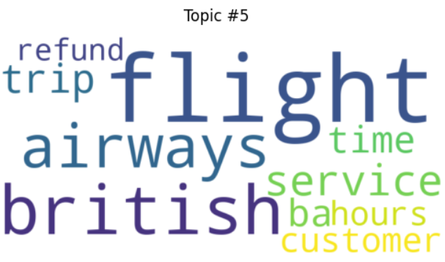
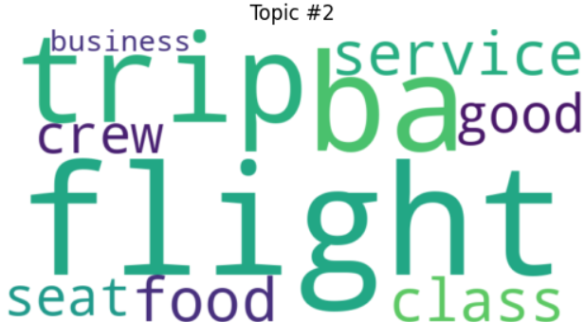
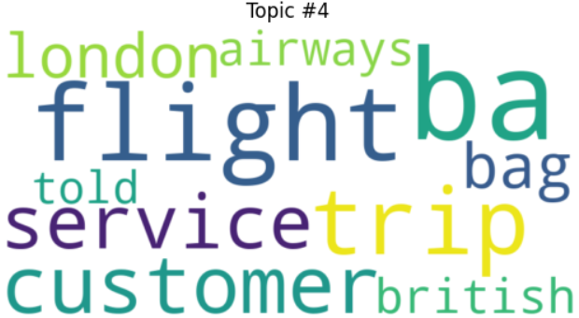
Text & Data Analytics
Topic Modelling using LDA

Slide 9
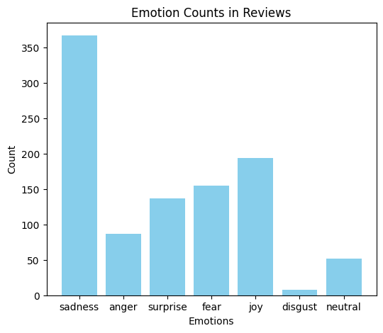
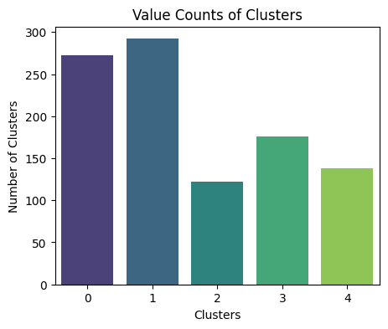
Text & Data Analytics
Emotions Distribution using Emotion DistilRoberta Model and sentiment analysis.
Using Kmeans we found out the distribution in the clusters.

Slide 10
Summary
We got to know that we have more verified reviews that means those reviews are genuine and true.
We have more Negative reviews that means we need to check on the topic and investigate where we need to focus.
With Emotion Analysis we see that the maximum number of customer are sad from the service or the facility.

Slide 11
Thank You

